Slide 1


Harshit Sharma
11-08-2024

Slide 2

Outline
Executive Summary
Introduction
Methodology
Results
Conclusion
Appendix

Slide 3
Executive Summary
Summary of methodologies
Data Collection through API
Data Collection with Web Scraping
Data Wrangling
Exploratory Data Analysis with SQL
Exploratory Data Analysis with Data Visualization
Interactive Visual Analytics with Folium
Machine Learning Prediction
Summary of all results
Exploratory Data Analysis result
Interactive analytics in screenshots
Predictive Analytics result

Slide 4
Introduction
Project background and context: SpaceX promotes its Falcon 9 rocket launches on its website with a price tag of $62 million, significantly lower than other providers whose costs exceed $165 million. A major factor contributing to SpaceX's cost savings is the ability to reuse the first stage of the rocket. By predicting whether the first stage will successfully land, we can estimate the overall launch cost and provide valuable insights for competing companies considering bids against SpaceX. The aim of this project is to develop a machine learning pipeline capable of forecasting the likelihood of a successful landing for the Falcon 9’s first stage.
Problems you want to find answers:
What factors influence the successful landing of the rocket’s first stage?
How do interactions among various features affect the success rate of a landing?
What operational conditions must be met to ensure a successful landing program?

Slide 5

Section 1

Slide 6
Methodology
Executive Summary
Data collection methodology:
SpaceX API
Web Scrapping from Wikipedia
Perform data wrangling
Using One hot encoding
Perform exploratory data analysis (EDA) using visualization and SQL
Perform interactive visual analytics using Folium and Plotly Dash
Perform predictive analysis using classification models

Slide 7
Data Collection
The data was collected using SpaceX API and Wikipedia using different techniques.

Slide 8
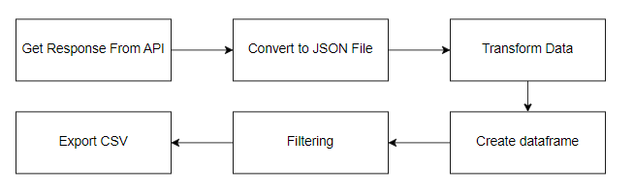
Data Collection – SpaceX API
Link: https://github.com/HarshitSharmaWorks/Capstone_IBM/blob/main/Data%20Collection%20API.ipynb

Slide 9
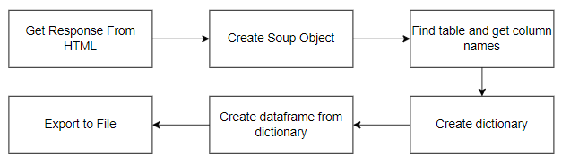
Data Collection - Scraping
Link: https://github.com/HarshitSharmaWorks/Capstone_IBM/blob/main/Web%20Scraping.ipynb

Slide 10
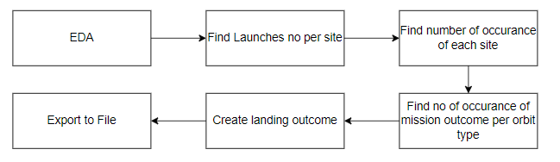
Data Wrangling
Describe how data were processed: At first EDA performed on the dataset. Then we calculated the summaries launches per site, occurrences of each orbit and occurrences of mission outcome per orbit type. Finally, the landing outcome label was created from Outcome column.
Link: https://github.com/HarshitSharmaWorks/Capstone_IBM/blob/main/EDA.ipynb

Slide 11
EDA with Data Visualization
Three charts were plotted: Scatter Graphs: Shows relationship Bar Charts: Shows Comparison Line Charts: Shows trends
Link: https://github.com/HarshitSharmaWorks/Capstone_IBM/blob/main/EDA%20Visualization.ipynb

Slide 12
EDA with SQL
Displaying the names of the unique launch sites in the space mission
Displaying 5 records where launch sites begin with the string ‘CCA’
Displaying the total payload mass carried by boosters launched by NASA (CRS)
Displaying average payload mass carried by booster version F9 v1.1
Listing the date when the first successful landing outcome in ground pad was achieved
Listing the names of the boosters which have success in drone ship and have payload mass greater than 4000 but less than 6000
Listing the total number of successful and failure mission outcomes
Listing the names of the booster versions which have carried the maximum payload mass
Listing the failed landing outcomes in drone ship, their booster versions and launch site names for the months in year 2015
Ranking the count of landing outcomes (such as Failure (drone ship) or Success (ground pad)) between the date 2010-06-04 and 2017-03-20 in descending order
Link: https://github.com/HarshitSharmaWorks/Capstone_IBM/blob/main/EDA%20with%20SQL.ipynb

Slide 13
Build an Interactive Map with Folium
Markers shows the point like launch sites Circle shows the area around some coordinates Marker cluster shows group of event in each coordinates Lines are used to find distance between two coordinates
Link: https://github.com/HarshitSharmaWorks/Capstone_IBM/blob/main/Interactive%20Visual%20Analytics%20with%20Folium_Lab.ipynb

Slide 14
Build a Dashboard with Plotly Dash
Launch site dropdown list for selecting the lauch site Pie chart for showing success rate Slider for payload mass range And final scatter chart for showing correlation
Link: https://github.com/HarshitSharmaWorks/Capstone_IBM/blob/main/Final%20Dash%20Application.py

Slide 15
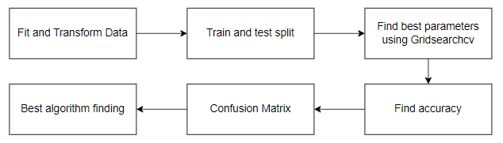
Predictive Analysis (Classification)
We use 4 algorithms: Logistic Regression SVM Decision Tree KNN
Link: https://github.com/HarshitSharmaWorks/Capstone_IBM/blob/main/Machine%20Learning%20Prediction_Lab.ipynb

Slide 16
Results
Exploratory data analysis results
Interactive analytics demo in screenshots
Predictive analysis results

Slide 17

Section 2

Slide 18
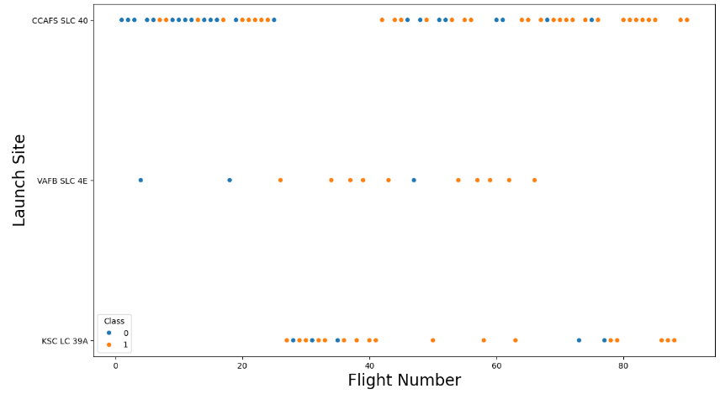
Flight Number vs. Launch Site
Recent have high success rate
VAFB SLC 4E and KSC LC 39A Have low failure rate
Over time success rate is increasing

Slide 19
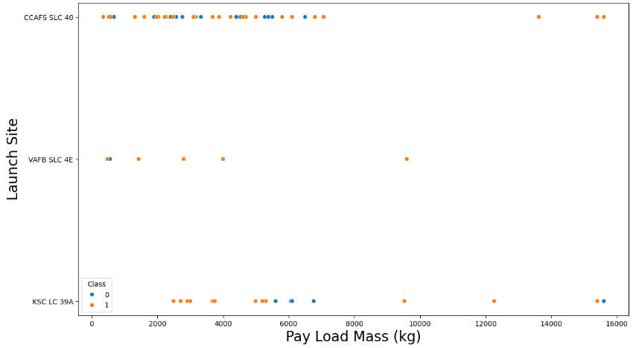
Payload vs. Launch Site
High payload mass means high success. But too heavy payload can make failure

Slide 20
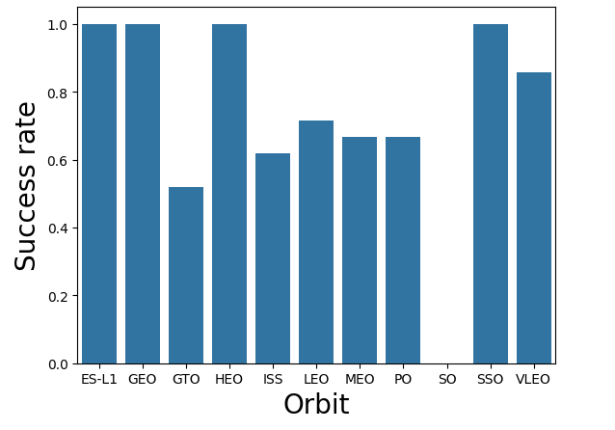
Success Rate vs. Orbit Type
This bar graph show success rate of different orbit types.
SO have 0% success rate
GEO,HEO,SSO,ES-L1 are some having 100% success rate

Slide 21
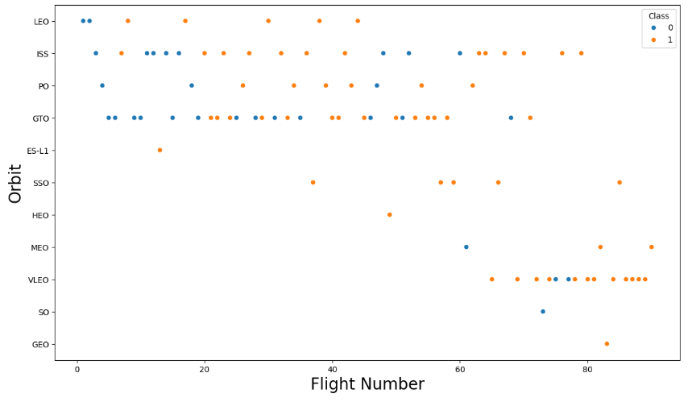
Flight Number vs. Orbit Type
Success rate increases with the number of flights for the LEO orbit
For GEO, No relation found according to this Chart.

Slide 22
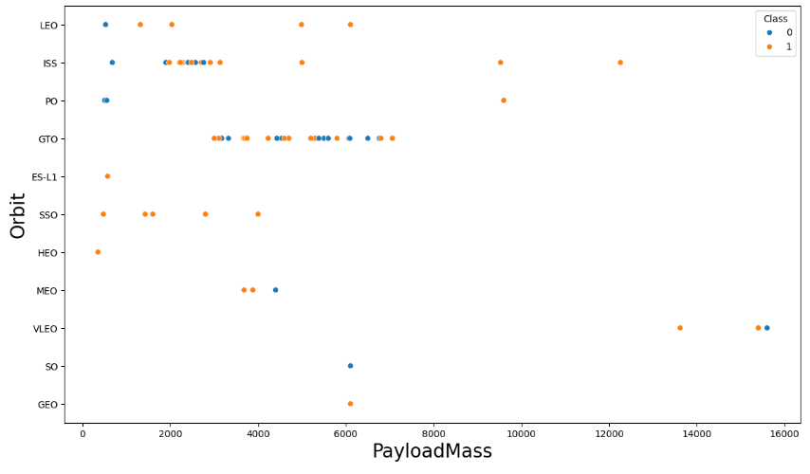
Payload vs. Orbit Type
Weight of the payloads make influence on the success rate of the launches in certain orbits.
Also decreasing the payload weight for a GTO orbit improves the success of a launch.

Slide 23
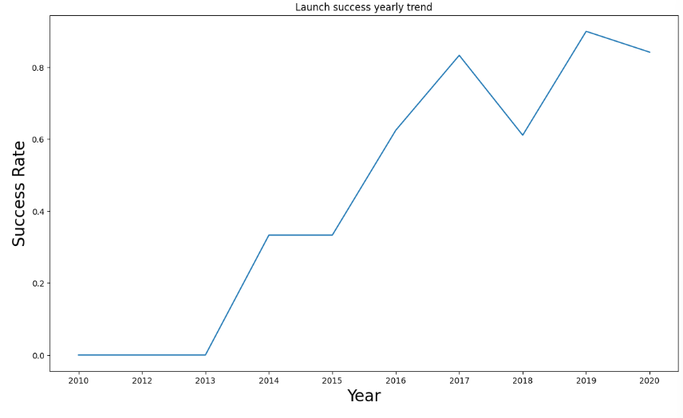
Launch Success Yearly Trend
After 2013, Success rate is very high

Slide 24
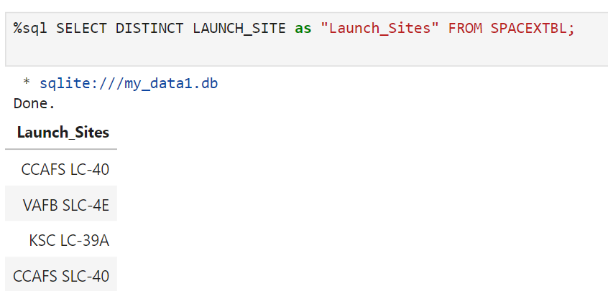
All Launch Site Names
Use distinct, to remove duplicate values

Slide 25
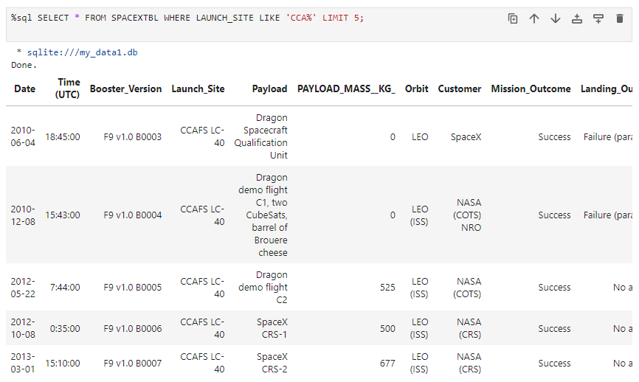
Launch Site Names Begin with 'CCA'
Use where and like function for getting the desired output

Slide 26
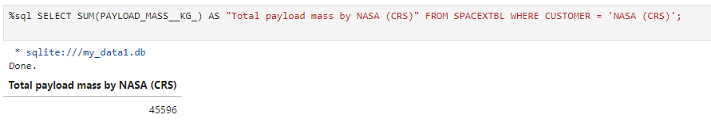
Total Payload Mass
Total Payload mass is 45596

Slide 27
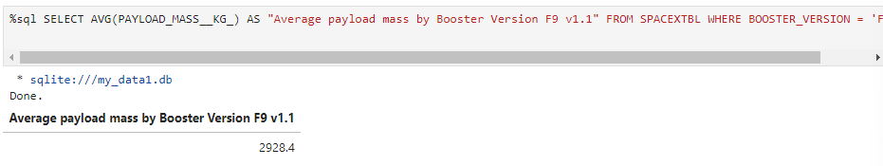
Average Payload Mass by F9 v1.1
Total payload mass by F9 v1.1 is 2928.4

Slide 28
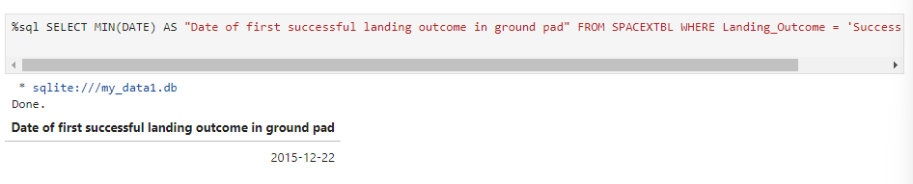
First Successful Ground Landing Date
First successful landing date is 22 December 2015

Slide 29
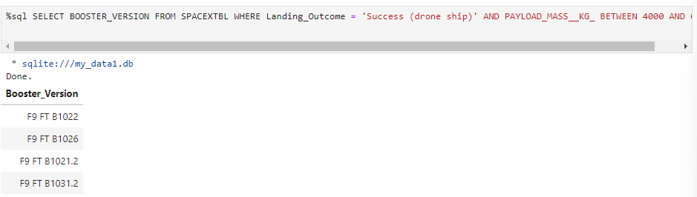
Successful Drone Ship Landing with Payload between 4000 and 6000

Slide 30
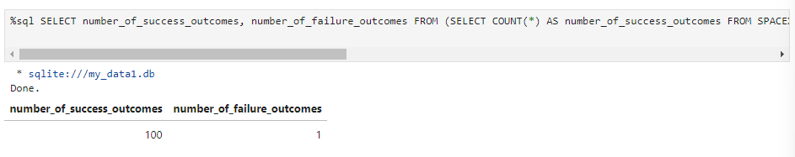
Total Number of Successful and Failure Mission Outcomes

Slide 31
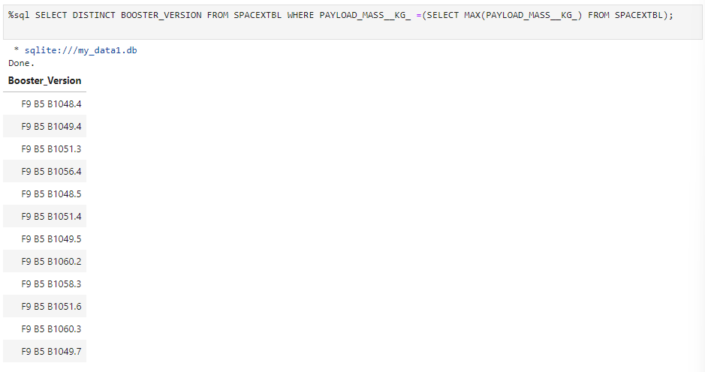
Boosters Carried Maximum Payload

Slide 32
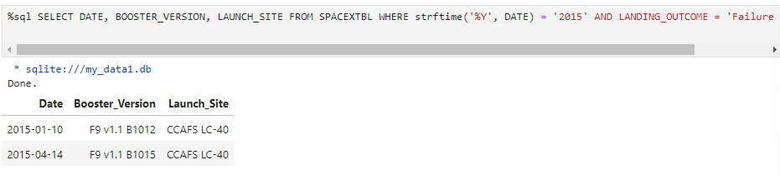
2015 Launch Records

Slide 33
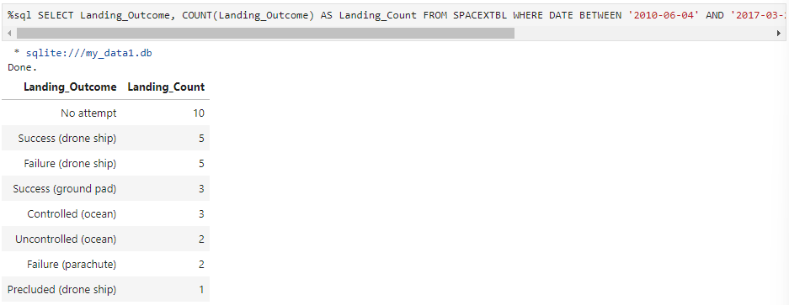
Rank Landing Outcomes Between 2010-06-04 and 2017-03-20

Slide 34

Section 3

Slide 35
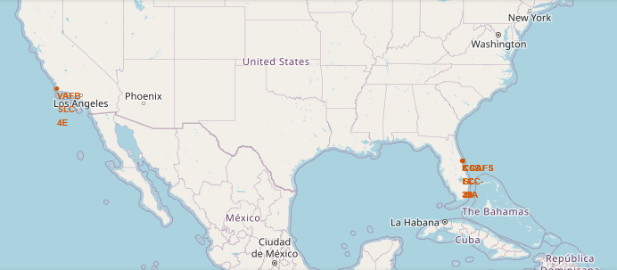
All Launch Site Locations
Launch sites are situated near sea

Slide 36
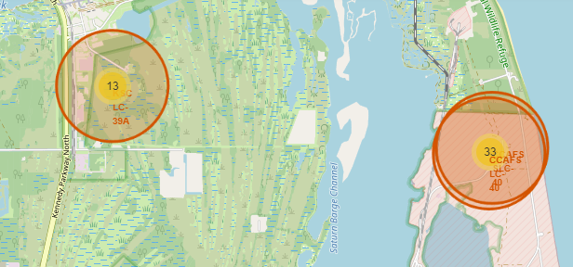
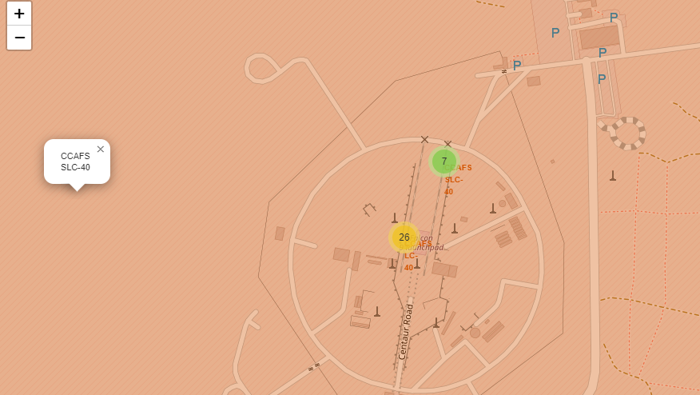
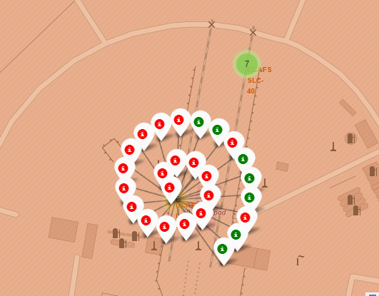
Color labeled Launch outcome by Site
Example of SLC-40
Green=Successful
Red=Failure

Slide 37
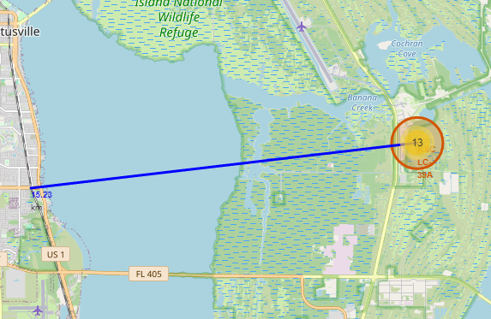
Distance from proximities
KSC LC 39A distance is shown from its proximities

Slide 38

Section 4

Slide 39
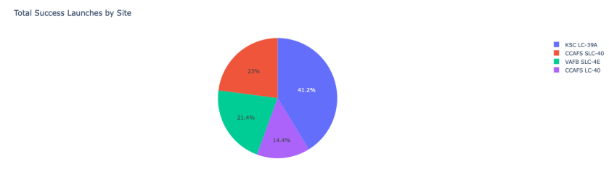
Success Count
KSC LC 39A have highest Success Rate

Slide 40
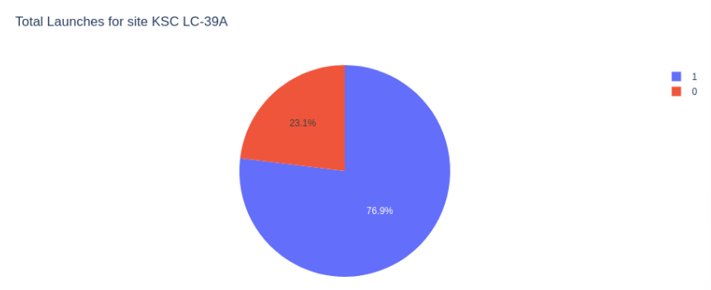
Success Ratio of KSC LC 39A
KSC LC 39A have 76.9% Success Launch

Slide 41
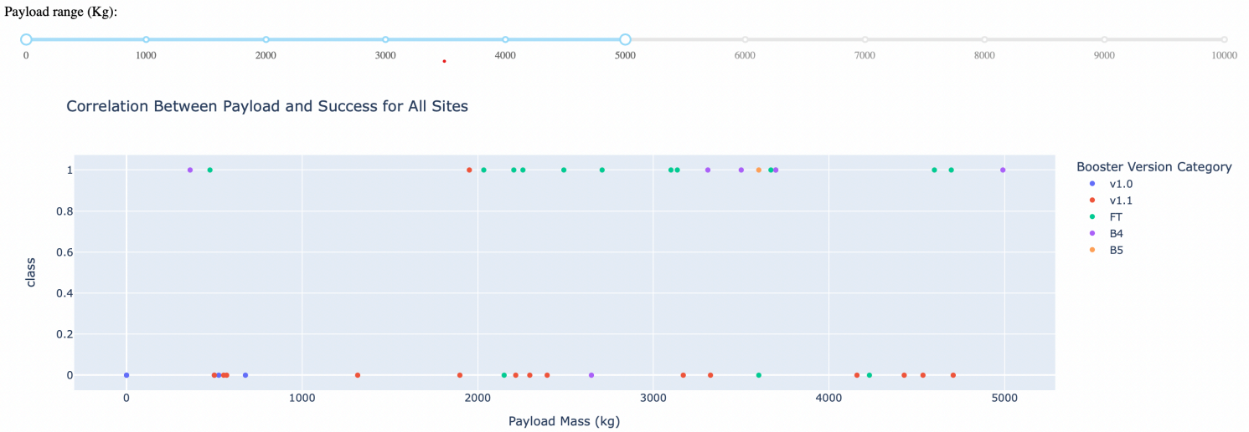
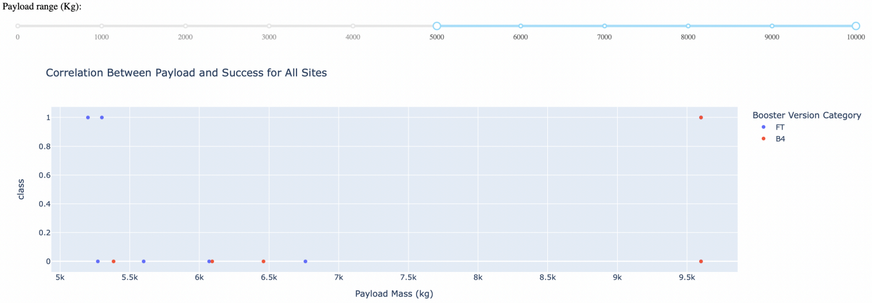
<Dashboard Screenshot 3>
Low Weighted payload mass have high success rate then high weighted payload mass

Slide 42

Section 5

Slide 43
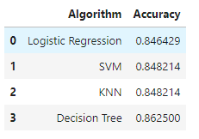
Classification Accuracy
4 classification model accuracies are given below
Decision tree have highest score

Slide 44
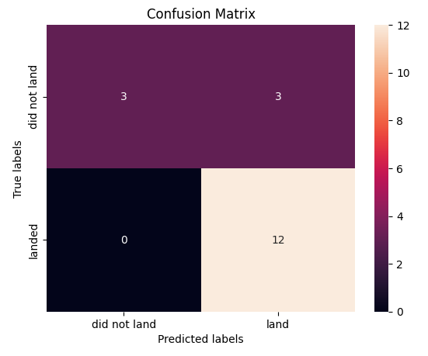
Confusion Matrix
After examine this we can say that all four algorithm have same confusion matrix due to same test accuracy.
The main issue in all of these algorithm is FALSE POSITIVE

Slide 45
Conclusions
Decision Tree is the best algorithm for this dataset
Low payload mass can increase the chance of successful launch
Overload Payload mass can decrease the success rate
Orbits ES-L!,GEO,HEO,SSO have 100% success rate
Best launch site is KSC LC 39A

Slide 46
Appendix
Thank You IBM and Coursera

Slide 47


